Slide 1





Component and Rest API JSON
Fauzi Sholichin
fauzisholih@gmail.com
+6289673732142
https://www.linkedin.com/in/fauzisho/

Slide 2
Introduction

Slide 3
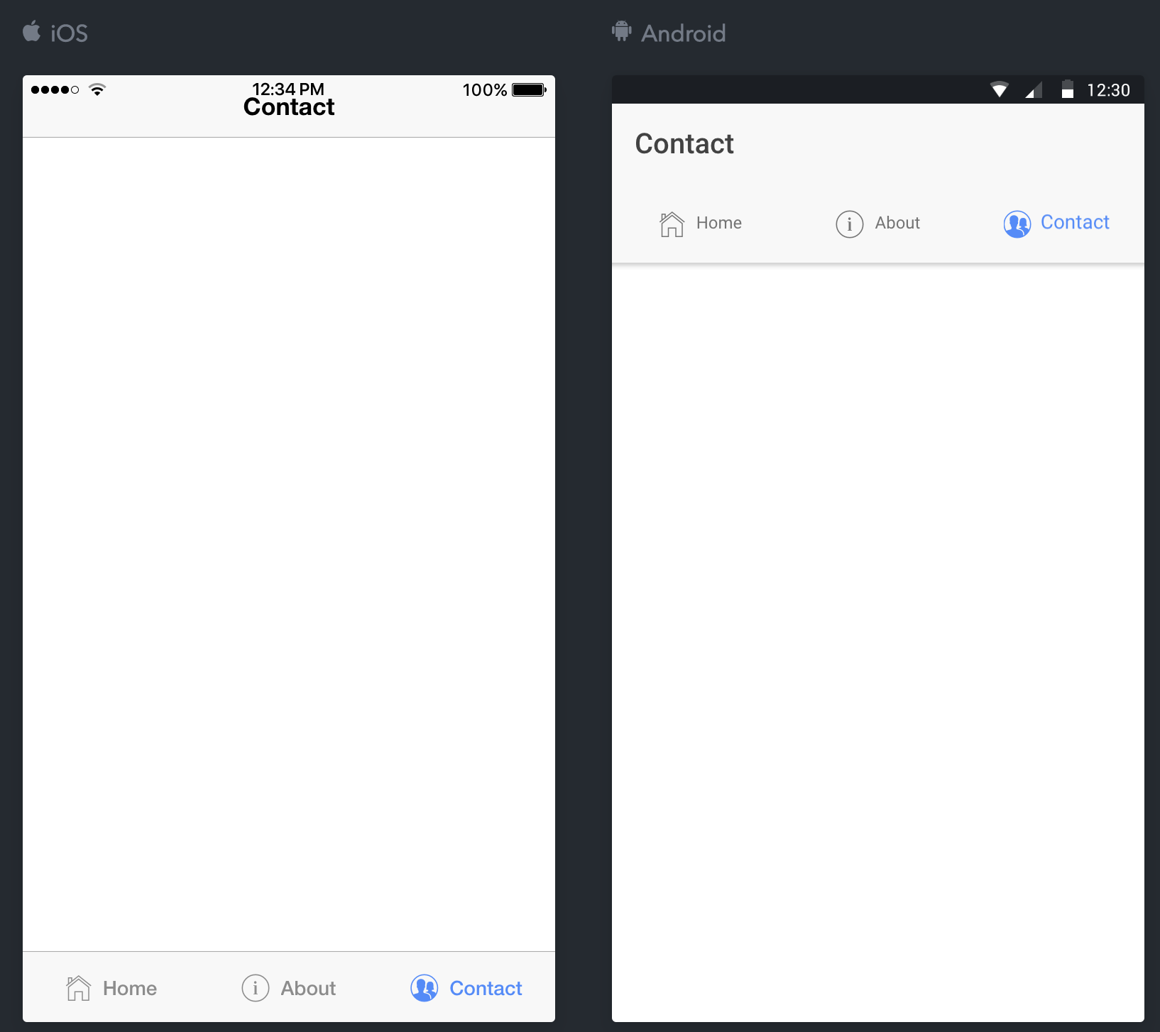
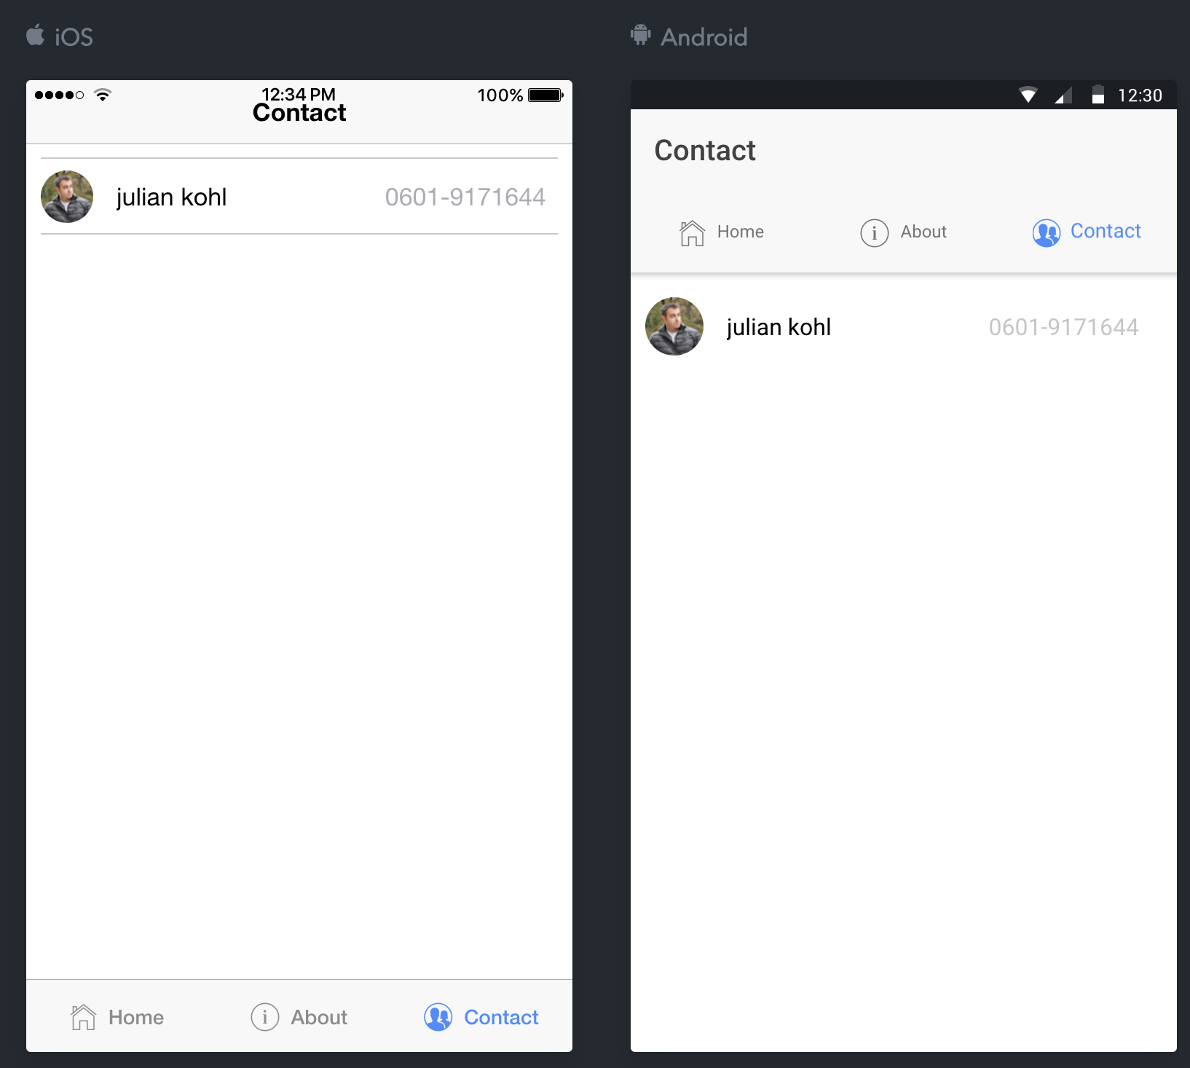
Introduction Menu Contact

Slide 4
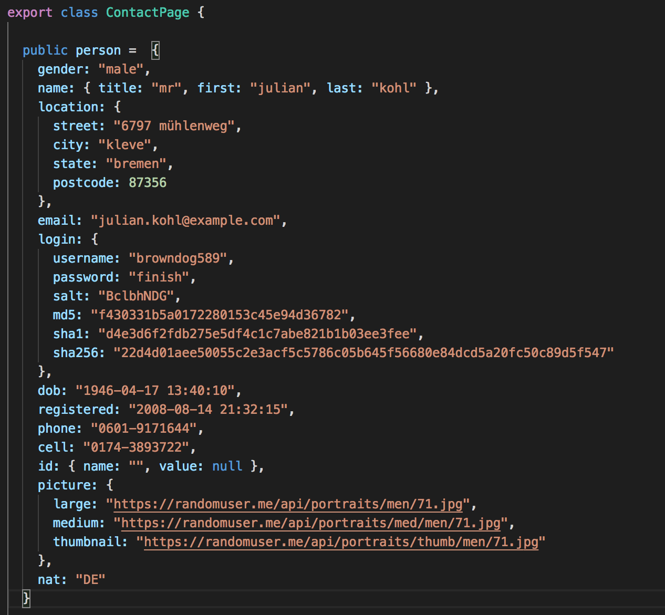
Introduction Menu Contact
contact.ts

Slide 5
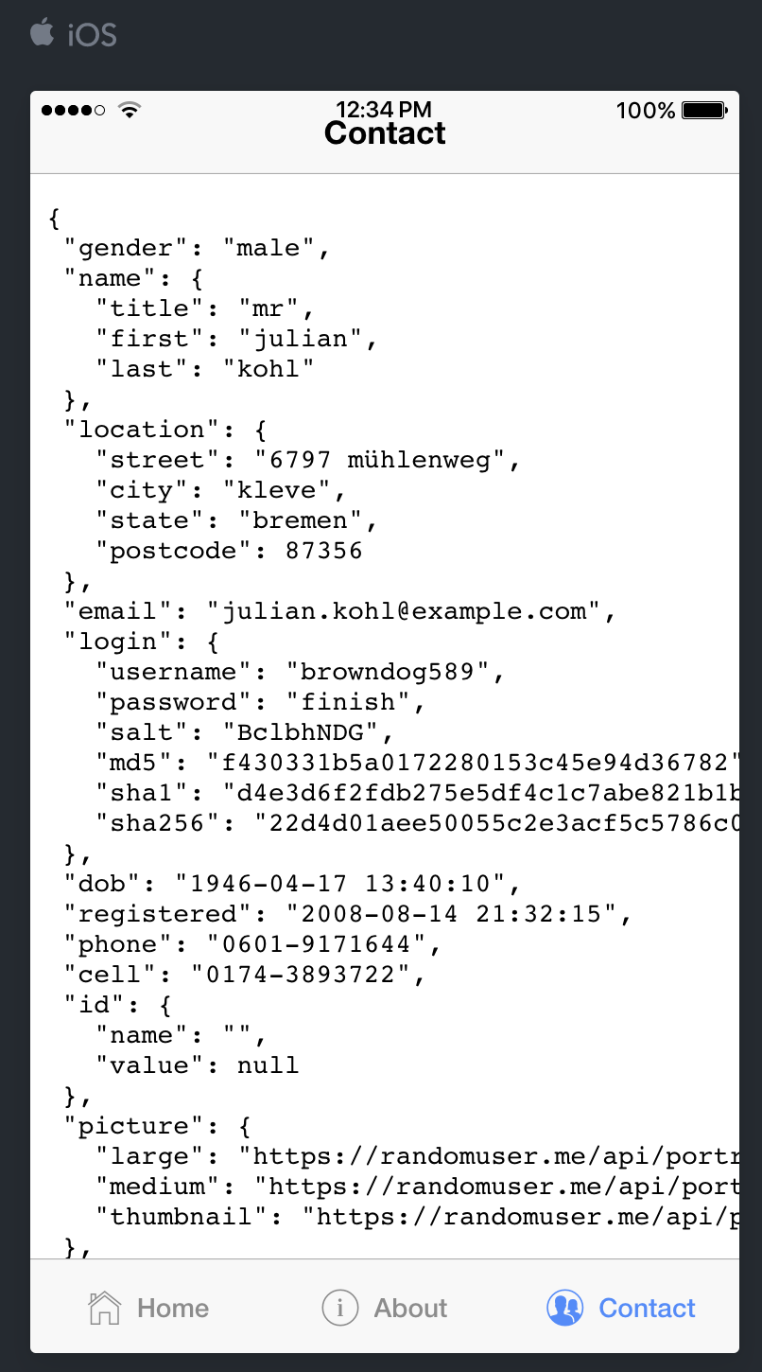
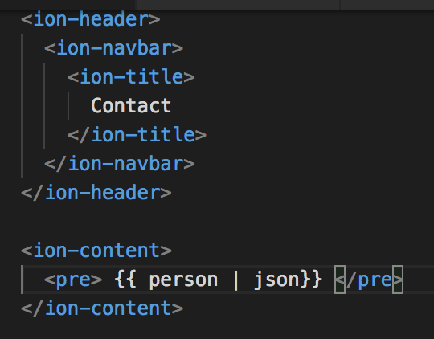
Introduction Menu Contact
contact.html

Slide 6
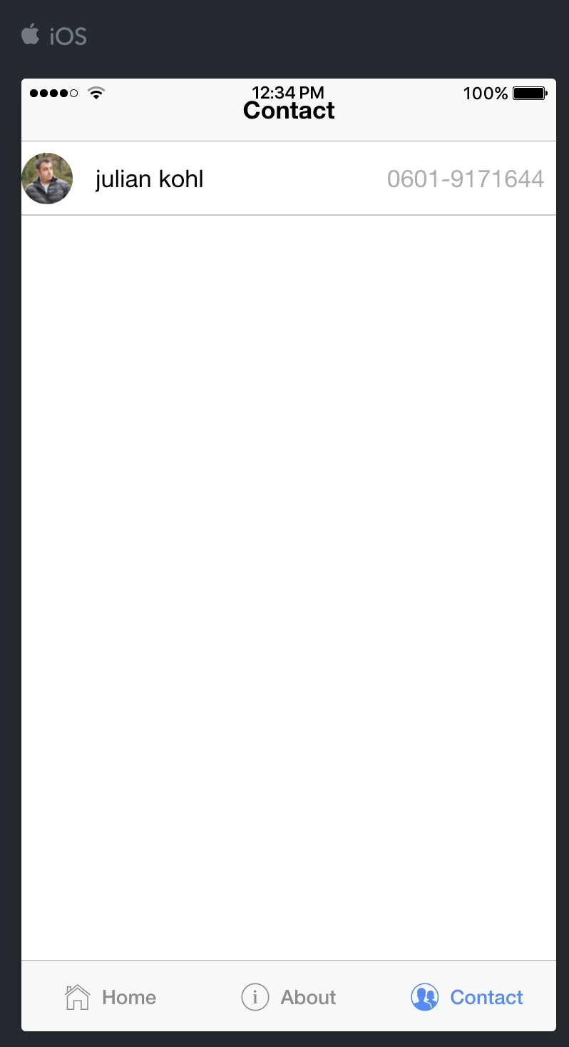
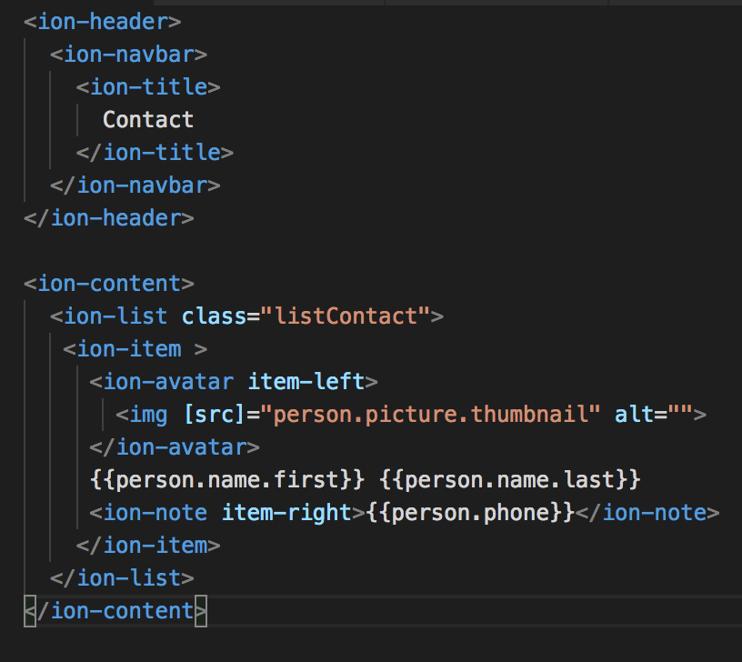
Introduction Menu Contact
contact.html

Slide 7
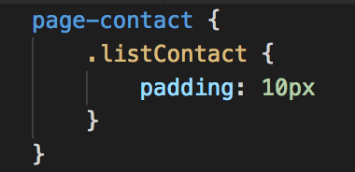
Introduction Menu Contact
contact.sass

Slide 8
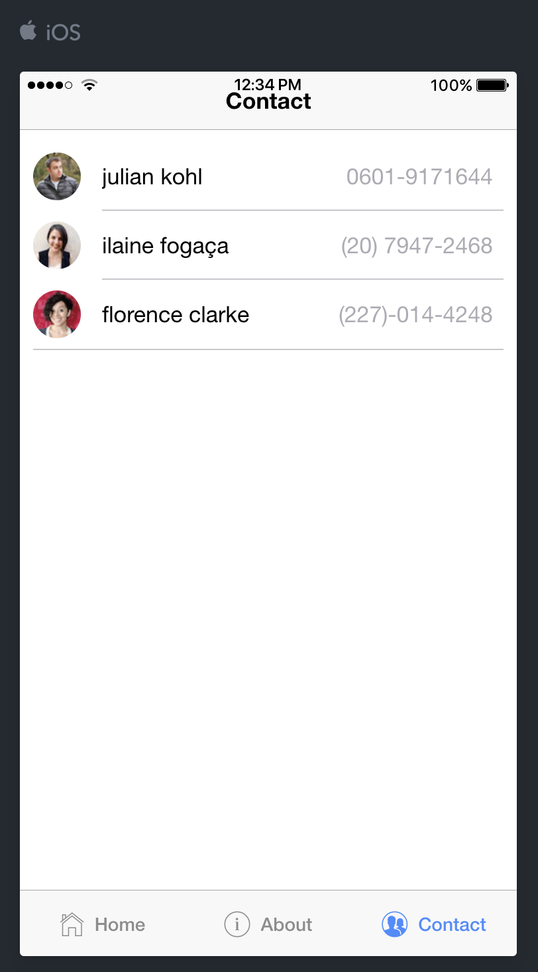
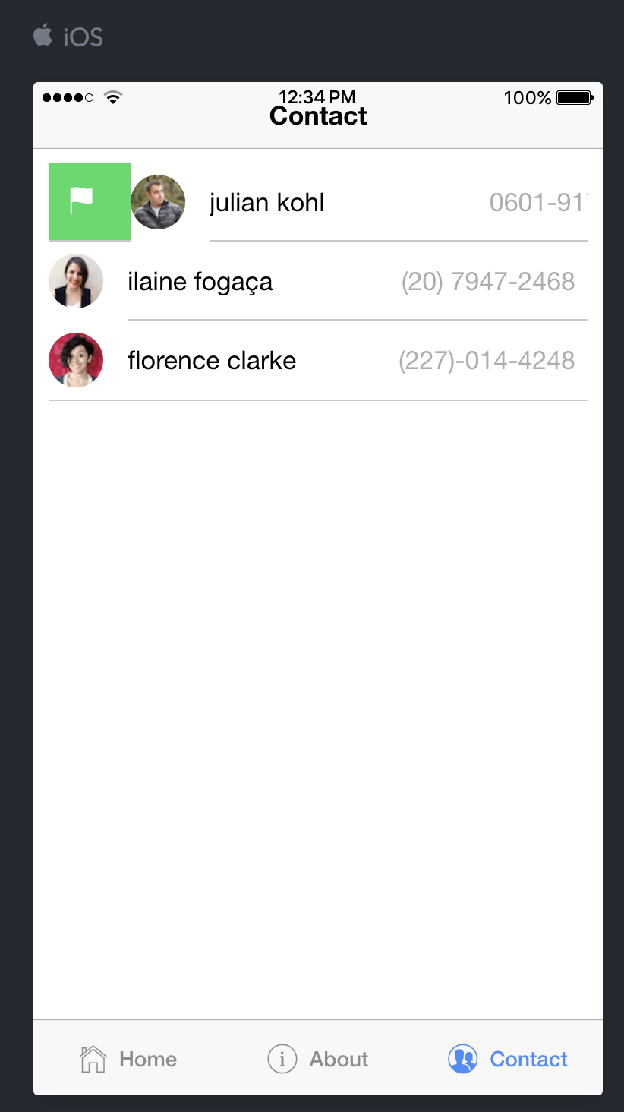
Introduction Menu List Contact

Slide 9
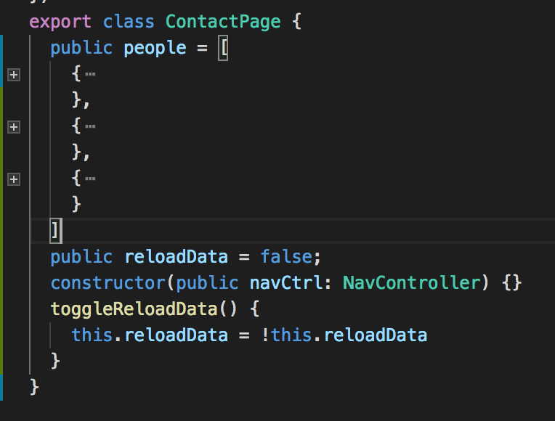
Introduction Menu List Contact
contact.ts

Slide 10
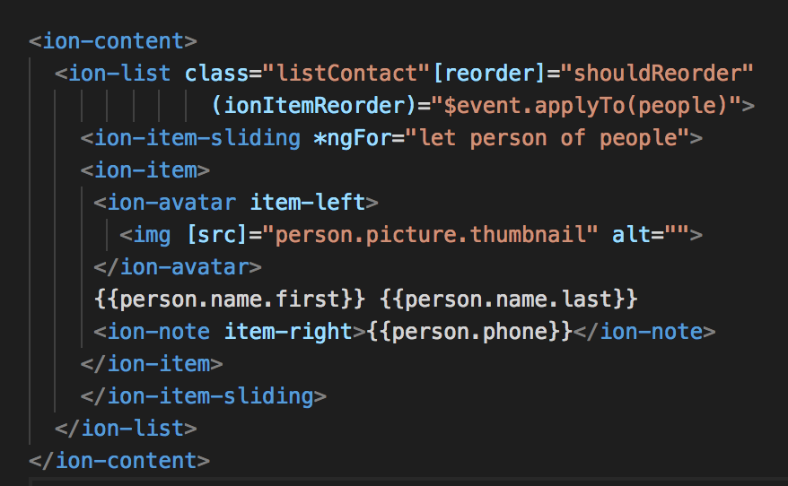
Introduction Menu List Contact
contact.html

Slide 11
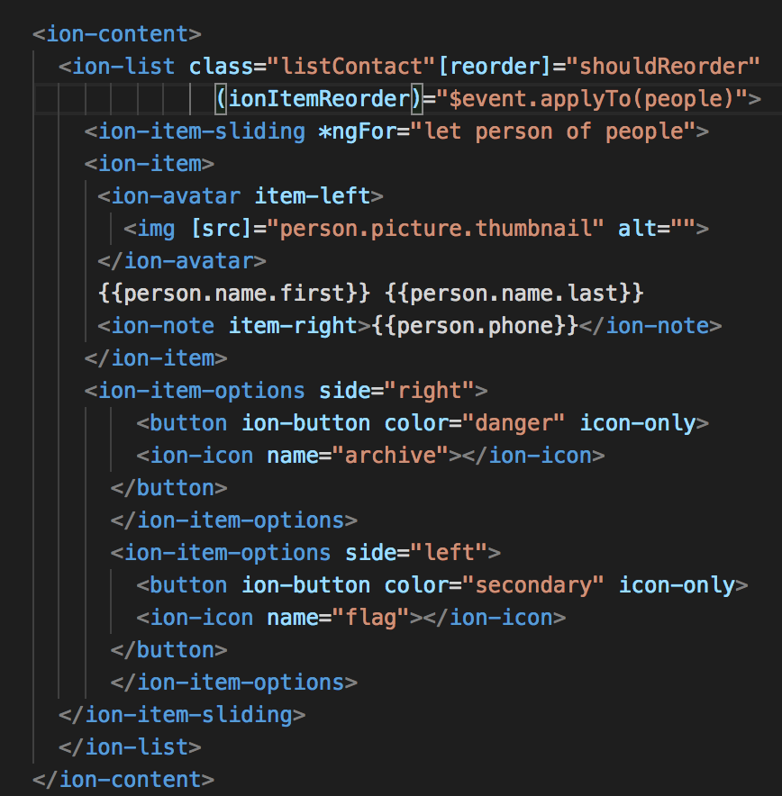
Introduction Menu List Contact
contact.html

Slide 12

Make Provider People
Open terminal
ionic g provider People

Slide 13
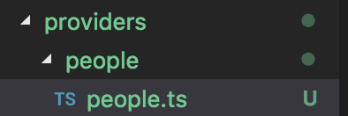
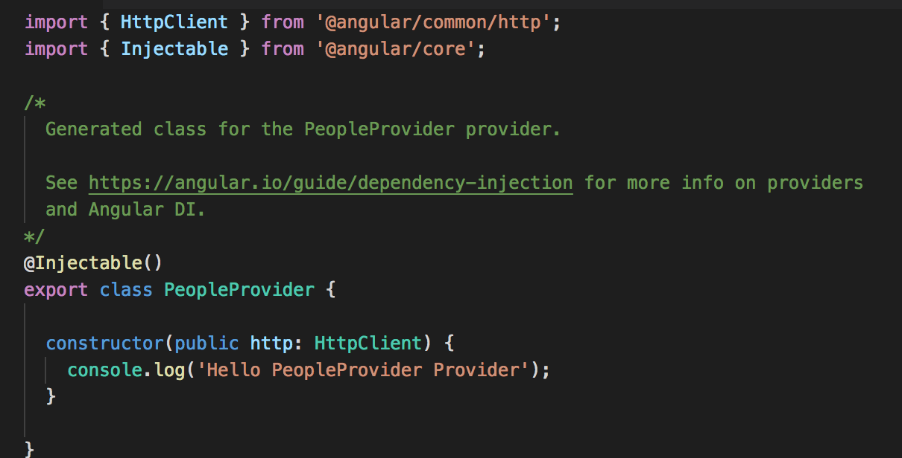
Make Provider People
Result :

Slide 14
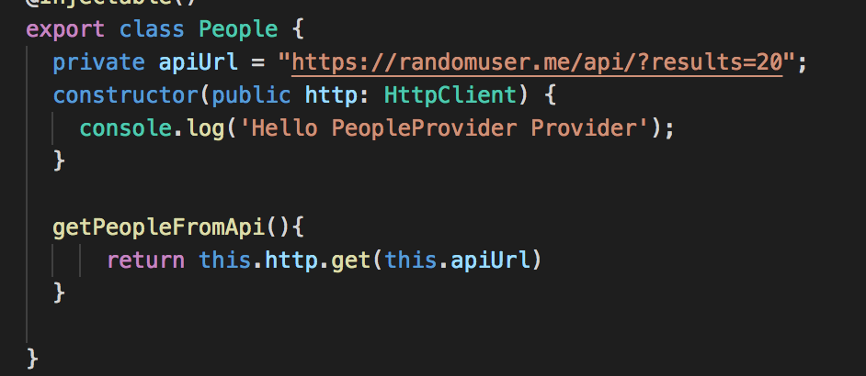
Sycn Provider People
people.ts

Slide 15
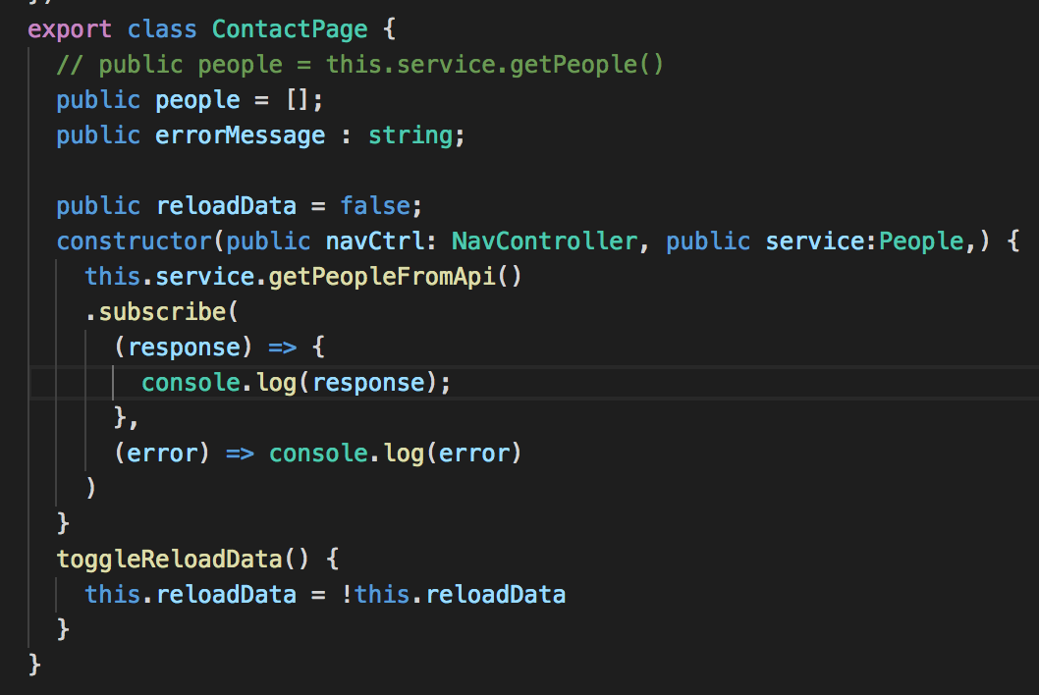
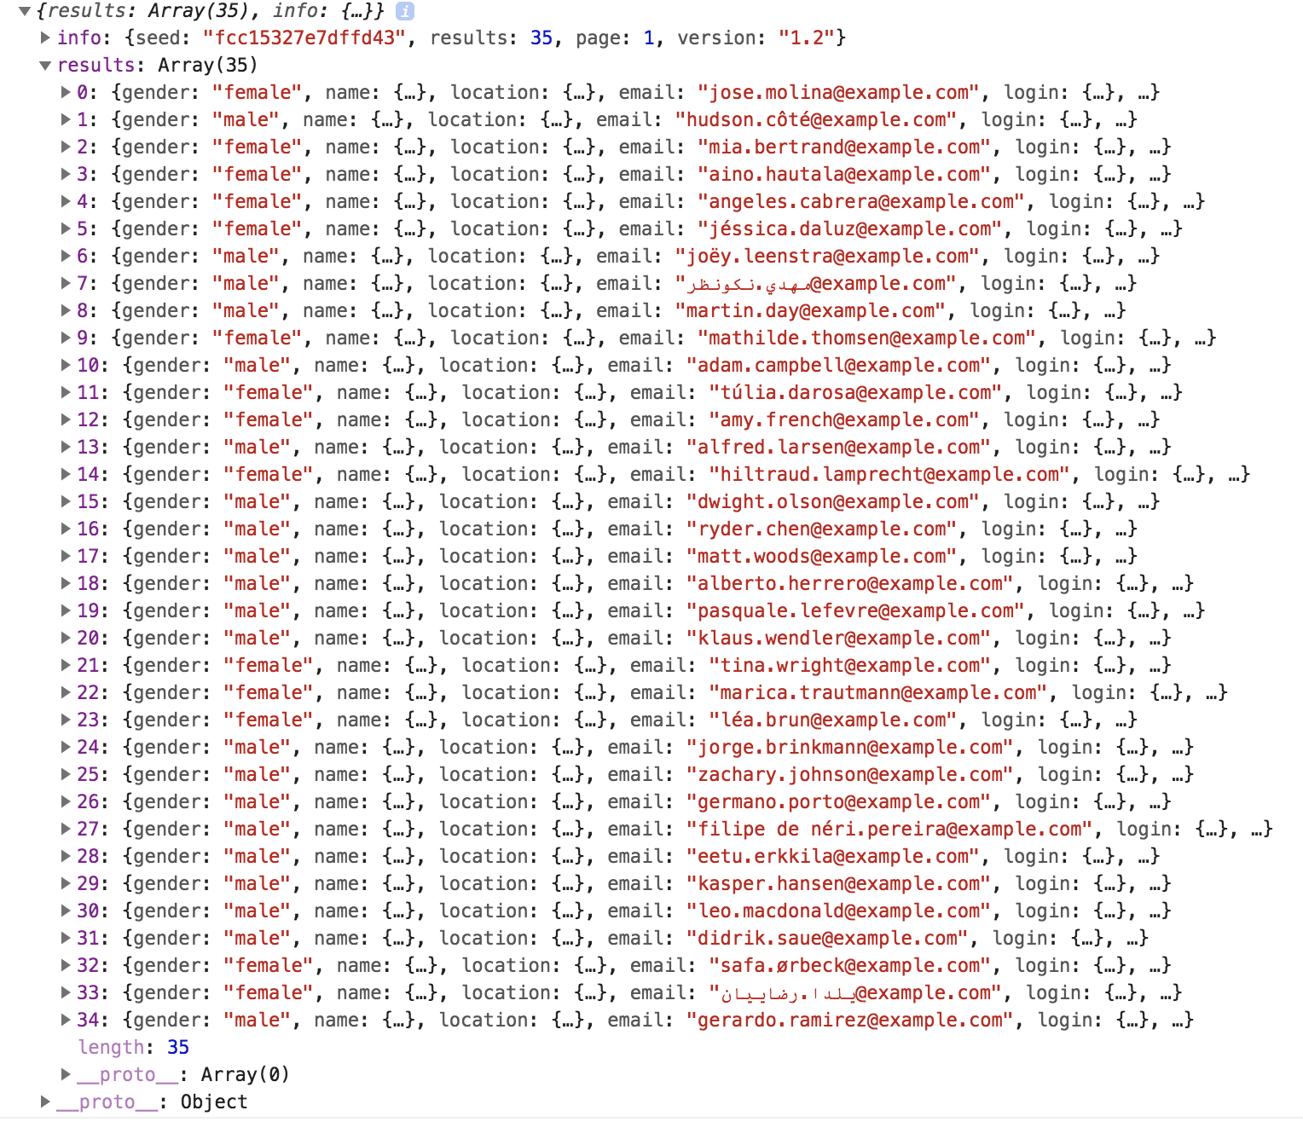
Sycn Provider People
contact.ts
console :

Slide 16
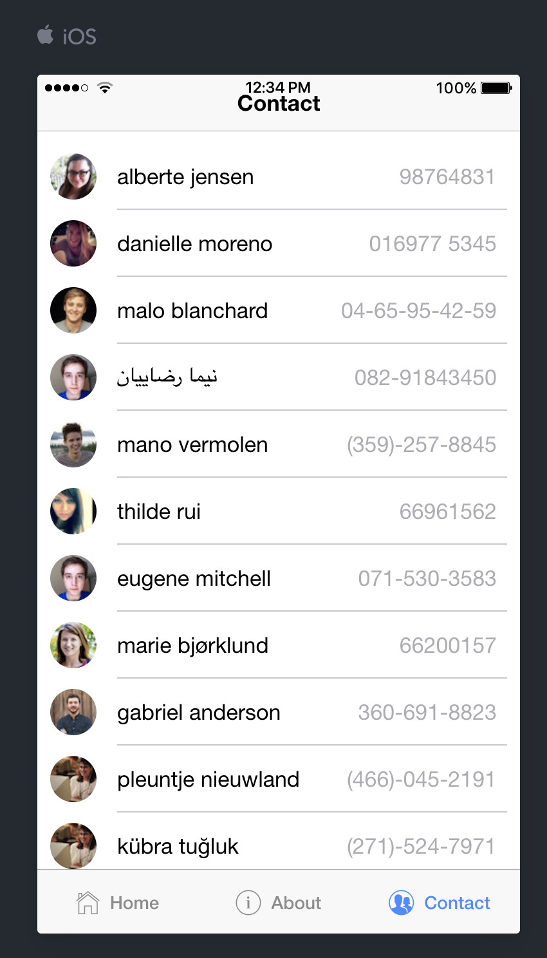
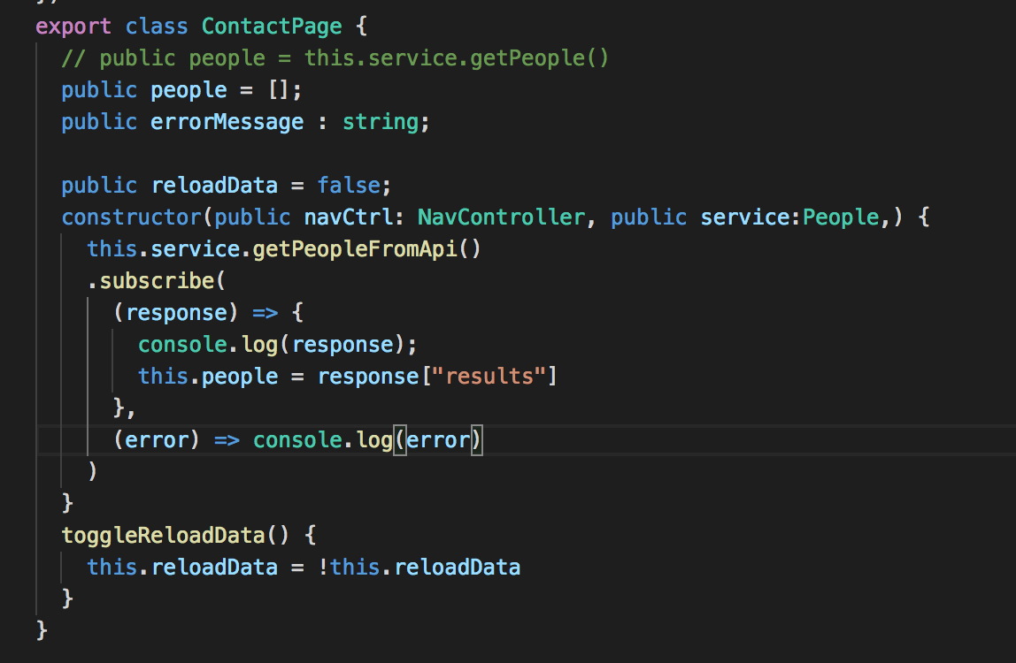
Sycn Provider People
contact.ts

